Slide 1
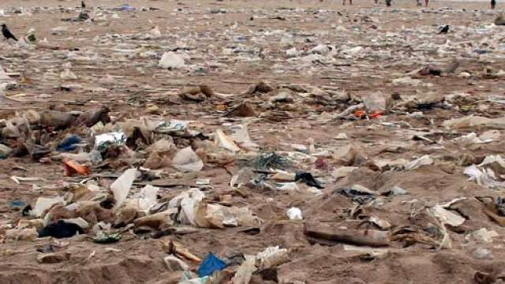
Soil Pollution

Slide 2
Soil Pollution
Soil pollution is defined as the contamination soil by human and natural activities which may cause harmful effects on living beains.

Slide 3
Industrial Effluents
Sources
Textile Industries.
Chemical Industries.
Oil Refineries.
Fertilizers Industries.
Sugar Factories.
Parma Industries.

Slide 4
Industrial Effluents
Effects
Affects the soil fertility.
Affects the Food chain.
Disturbs biochemical process.

Slide 5
Agricultural Wastes
Source
Huge Quantities of fertilizers are added in agricultural process.
Effects
Excess Nitrates creates cancer.
D.D.T., BHC, endrin, endosulfon. Long term effects on human beings.

Slide 6
Radioactive Pollutants
Sources
Atomic Reactor
Nuclear Radioactive Devices
Effects
Harmful to plants and Animals
Emitting radiations for long time.

Slide 7
Other Wastes
Urban wastes.
Biological agents.
Pesticides.
Chemical Pollutants.
Fertilizers.
Polymers, Plastics and Other Wastes.

Slide 8
Effects of Soil Pollution
Biological Soil pollution creates pathogenic bacteria.
Components containing arsenic, mercury, nickel, lead are all toxic to life.
Fluorides are also affects the plant developments.
Excess use of Na, Mb, Ca, K, S, Zn, Fe in the fertilizers and pesticides inhibit plant growth and reduces crop yield.
Water logging and salinity increases the dissolved salt contents.

Slide 9
Control of Soil Pollution
Control of soil erosion
Tree plantation.
Prevention of forest firing.
Reducing deforestation.
Natural Fertilizers
Avoid of Synthetic Fertilizers.
Fertilizers must be used according to the soil measures.
Bio pesticides are preferred choice.
Focus on Natural Agriculture.

Slide 10
Recycling and Reuse of wastes
Papers, plastics, metals glasses should be recycled.
Agriculture wastes like jute wastes and sugarcane wastes can be converted as paper.
Natural Gas Plants can be created.
Cow Dunk Gas Plants.

Slide 11
Other Methods
Proper dumping of unwanted wastes.
Avoid Open Dumping methods
Using scientific methods for dumping.
Public Awareness
Ban on Toxic Chemicals
Proper disposal of nuclear wastes.
Toxic chemicals should be banned.

